Slide 1
DOCKER PRACTICE

Slide 2
Docker basic concept
Docker image
Docer container
hub

Slide 3
install
Ubuntu 16 lts

Slide 4
Docker image
alpine

Slide 5
Dokcer hub
https://hub.docker.com/repository/docker/yiyang2009/iris

Slide 6
github
https://github.com/haixiang1977/iris/tree/master

Slide 7
architect
hyacinth
mosquitto
redis
petunia
azalea
docker
docker
docker
docker
docker
Ubuntu 16.04 LTS

Slide 8
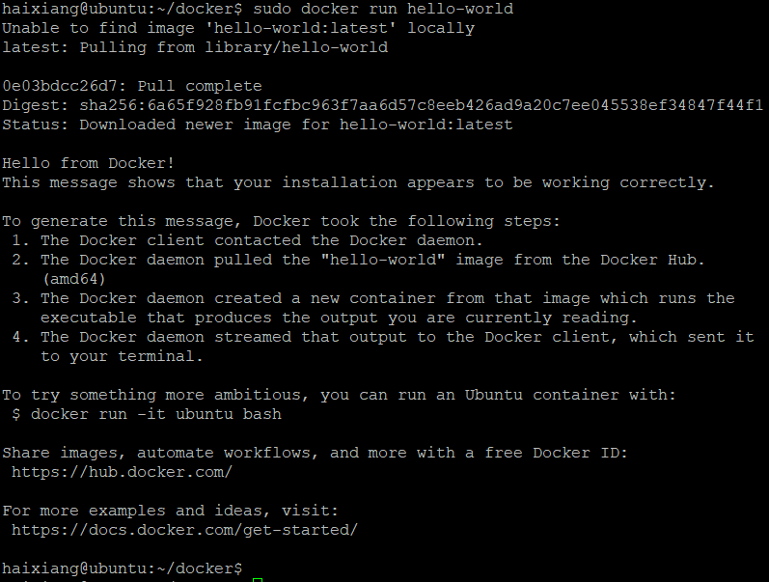
Install on ubuntu
https://docs.docker.com/engine/install/ubuntu/

Slide 9
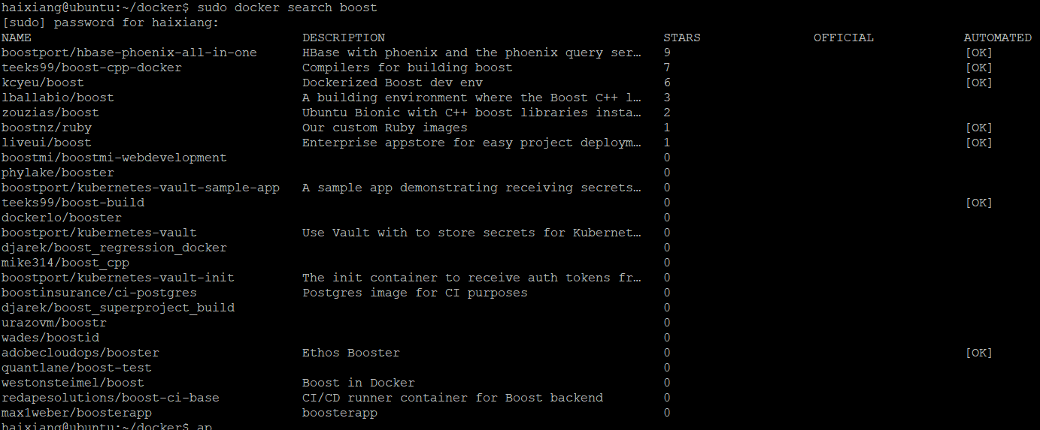
Find boost image
Sudo docker search boost – no official image

Slide 10
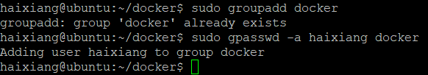
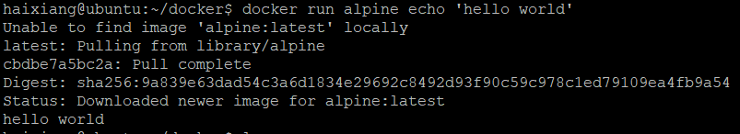
Run docker without sudo
https://askubuntu.com/questions/477551/how-can-i-use-docker-without-sudo

Slide 11
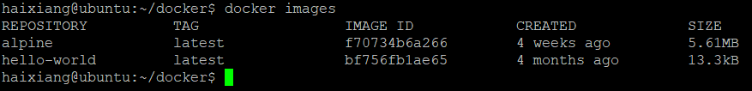
Check local installed image
docker images

Slide 12
Start from ubuntu image
To familiar docker operation first
Next is alpine image

Slide 13
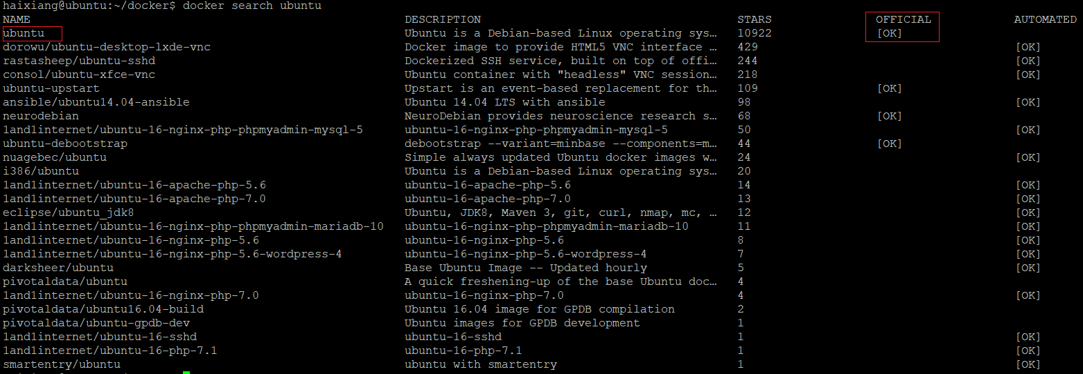
Start from ubuntu image
Search ubuntu image

Slide 14
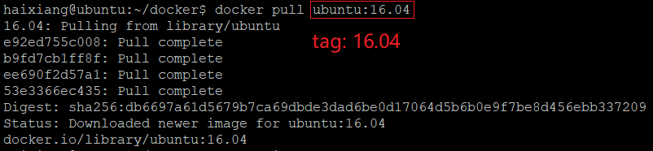
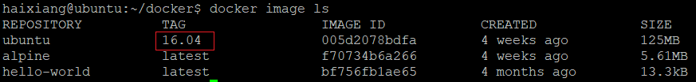
Start from ubuntu image (cont.)
Pull ubuntu 16.04 docker image

Slide 15
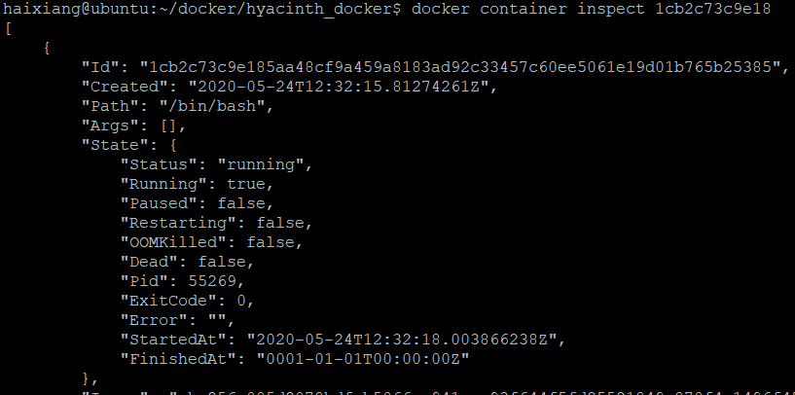
Start from ubuntu image (cont.)
Checking running port and ip

Slide 16
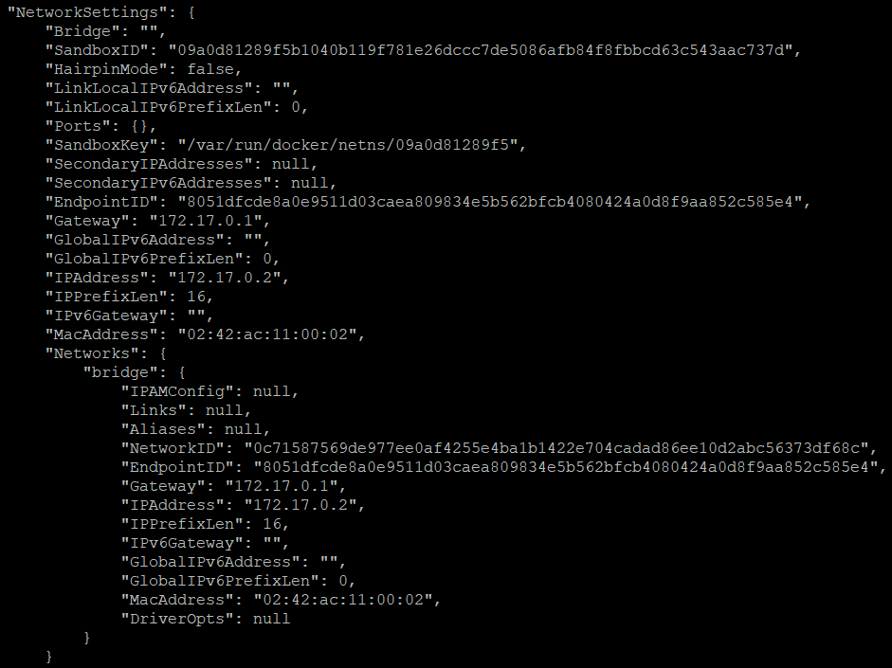
Start from ubuntu image (cont.)
Checking running port and ip (cont.)

Slide 17
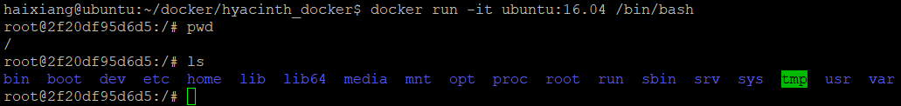
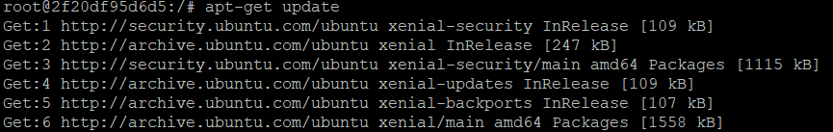
Build stage docker image – by manual
Run ubuntu:16.04 image with /bin/bash
docker run -it ubuntu:16.04 /bin/bash
Install packages

Slide 18
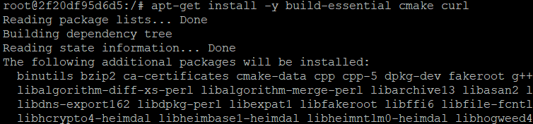
Build stage docker image (cont.)
Install packages (cont.)
Build dependency

Slide 19
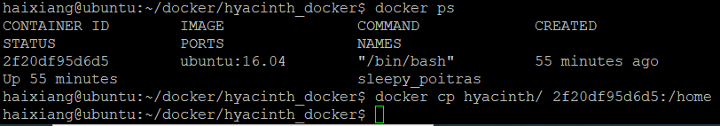
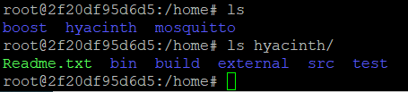
Build stage docker image (cont.)
COPY source code to running container
Host side docker copy
Container side

Slide 20

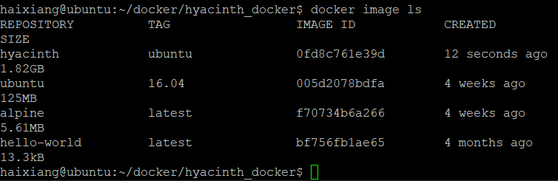
Build stage docker image (cont.)
Exit docker and docker commit to generate a new image

Slide 21
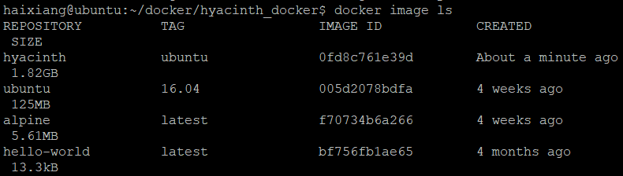
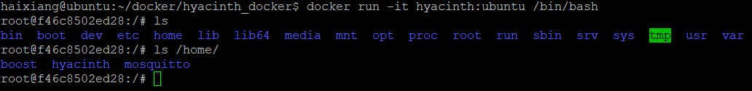
Build stage docker image (cont.)
Exit docker and docker commit to generate a new image

Slide 22
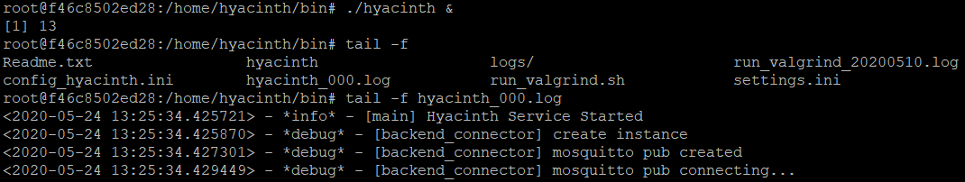
Build stage docker image (cont.)
Run application

Slide 23
Assign port
Mqtt default port is 1883
Host mqtt default port is 1883
Host
container
client
1883

Slide 24
Use docker file create image
Multi-stage build
Build stage docker image
Run-time stage docker image

Slide 25
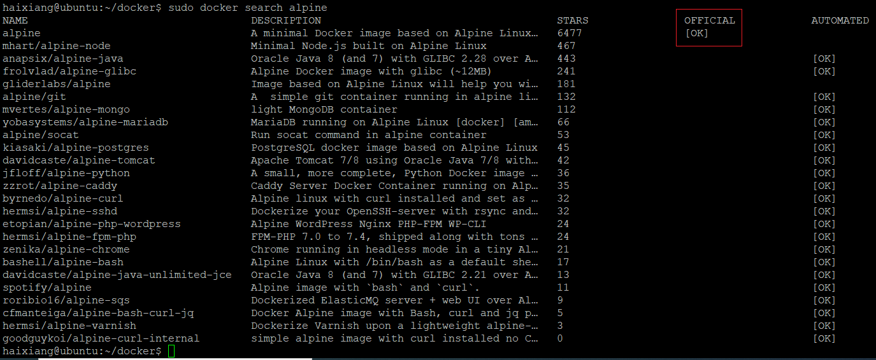
search alpine image
sudo docker search alpine

